Slide 1
Project Name
Members name

Slide 2
Problem Description
Automated Essay Grading with feedback

Slide 3
Methodologies and technologies used
Write technologies
Write data set and tell about it
Write the models we are using

Slide 4
Threshold
We needed to set a threshold of the difference in score between the essay and its chunks. If the chunk score is below essay score minus threshold, we that the chunk is a poor part of the essay.
We set that according to our RMSE. So our RMSE was about 0.16, so we set the threshold above the RMSE and set 0.30 as our threshold to be sure that the chunk is poor.

Slide 5

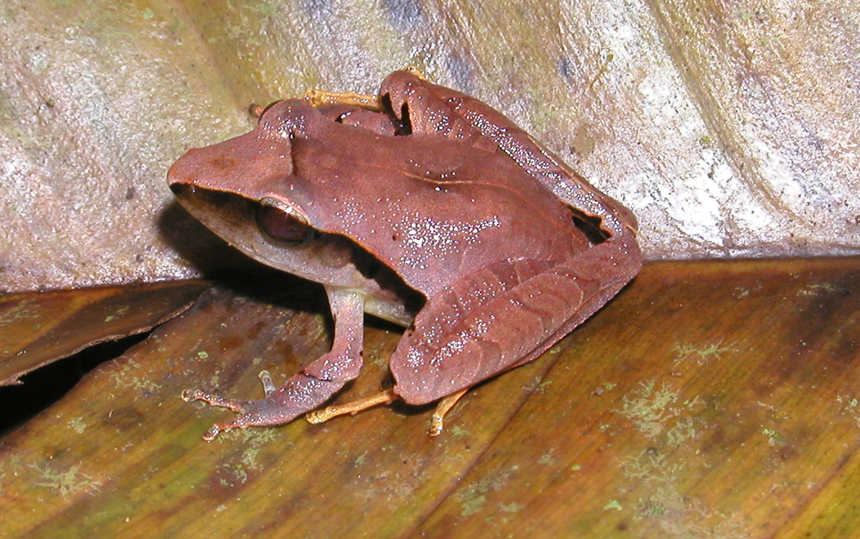
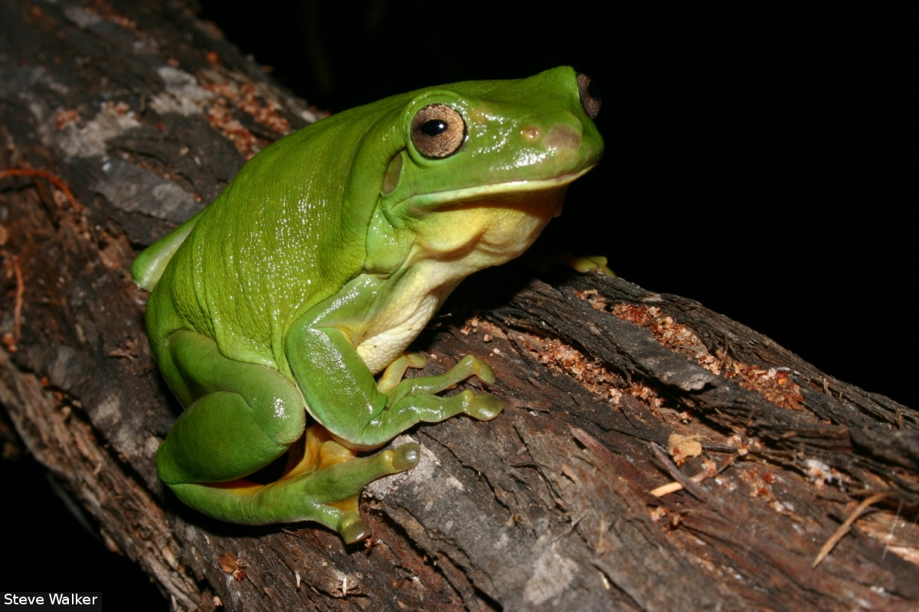
GloVe: Global Vectors for word representation
GloVe is an unsupervised learning algorithm for obtaining vector representations for words.
The nearest neighbors of the word ‘frog’ using GloVe: Frogs, Toad, litoria, leptodactylidae, rana, eleutherodactylus.

Slide 6
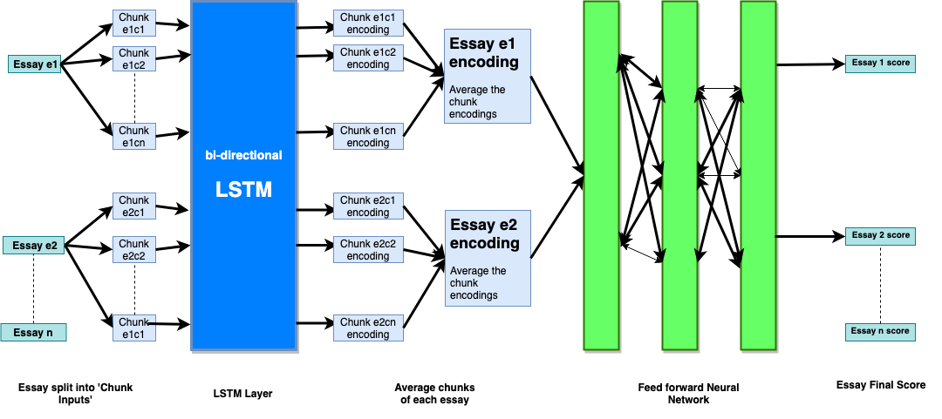
Our model

Slide 7
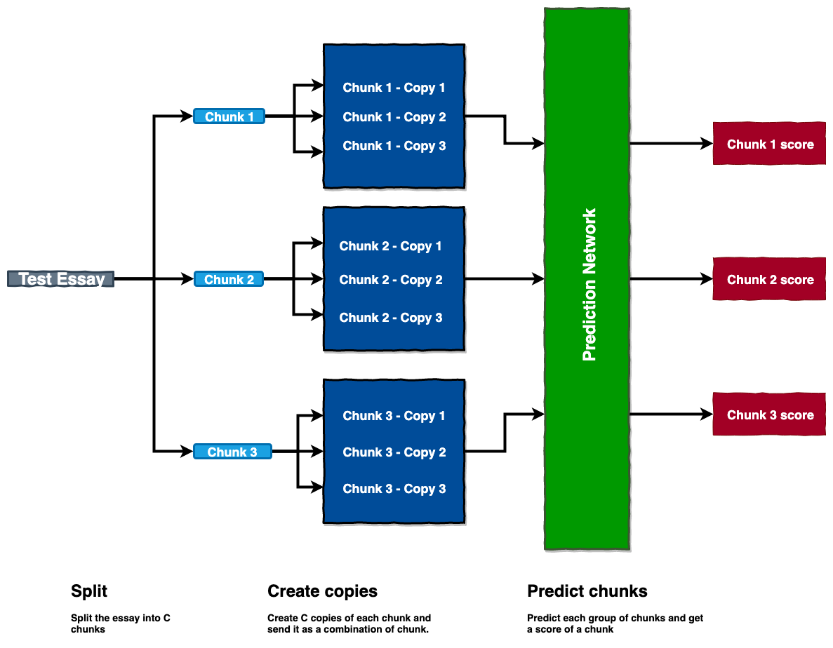
Chunk Prediction

Slide 8
Results : RMSE
Word embedding | LSTM | GRU | RNN | Single Layer LSTM
Glove vectors | 0.1639 | 0.17119 | 0.1839 | 0.1712
Word2vec (Pre-trained on GoogleNews) | 0.1692 | 0.17851 | 0.1851 | 0.1756

Slide 9
Related Work
https://web.stanford.edu/class/archive/cs/cs224n/cs224n.1174/reports/2731315.pdf
http://web.stanford.edu/class/cs224n/reports/custom/15722887.pdf
Hello
Hello

